Slide 1
HW2 Prim’s Algorithm
班級:四電子二B
姓名:曾皓暐
學號:B10213147
指導老師:郭柏佑

Slide 2
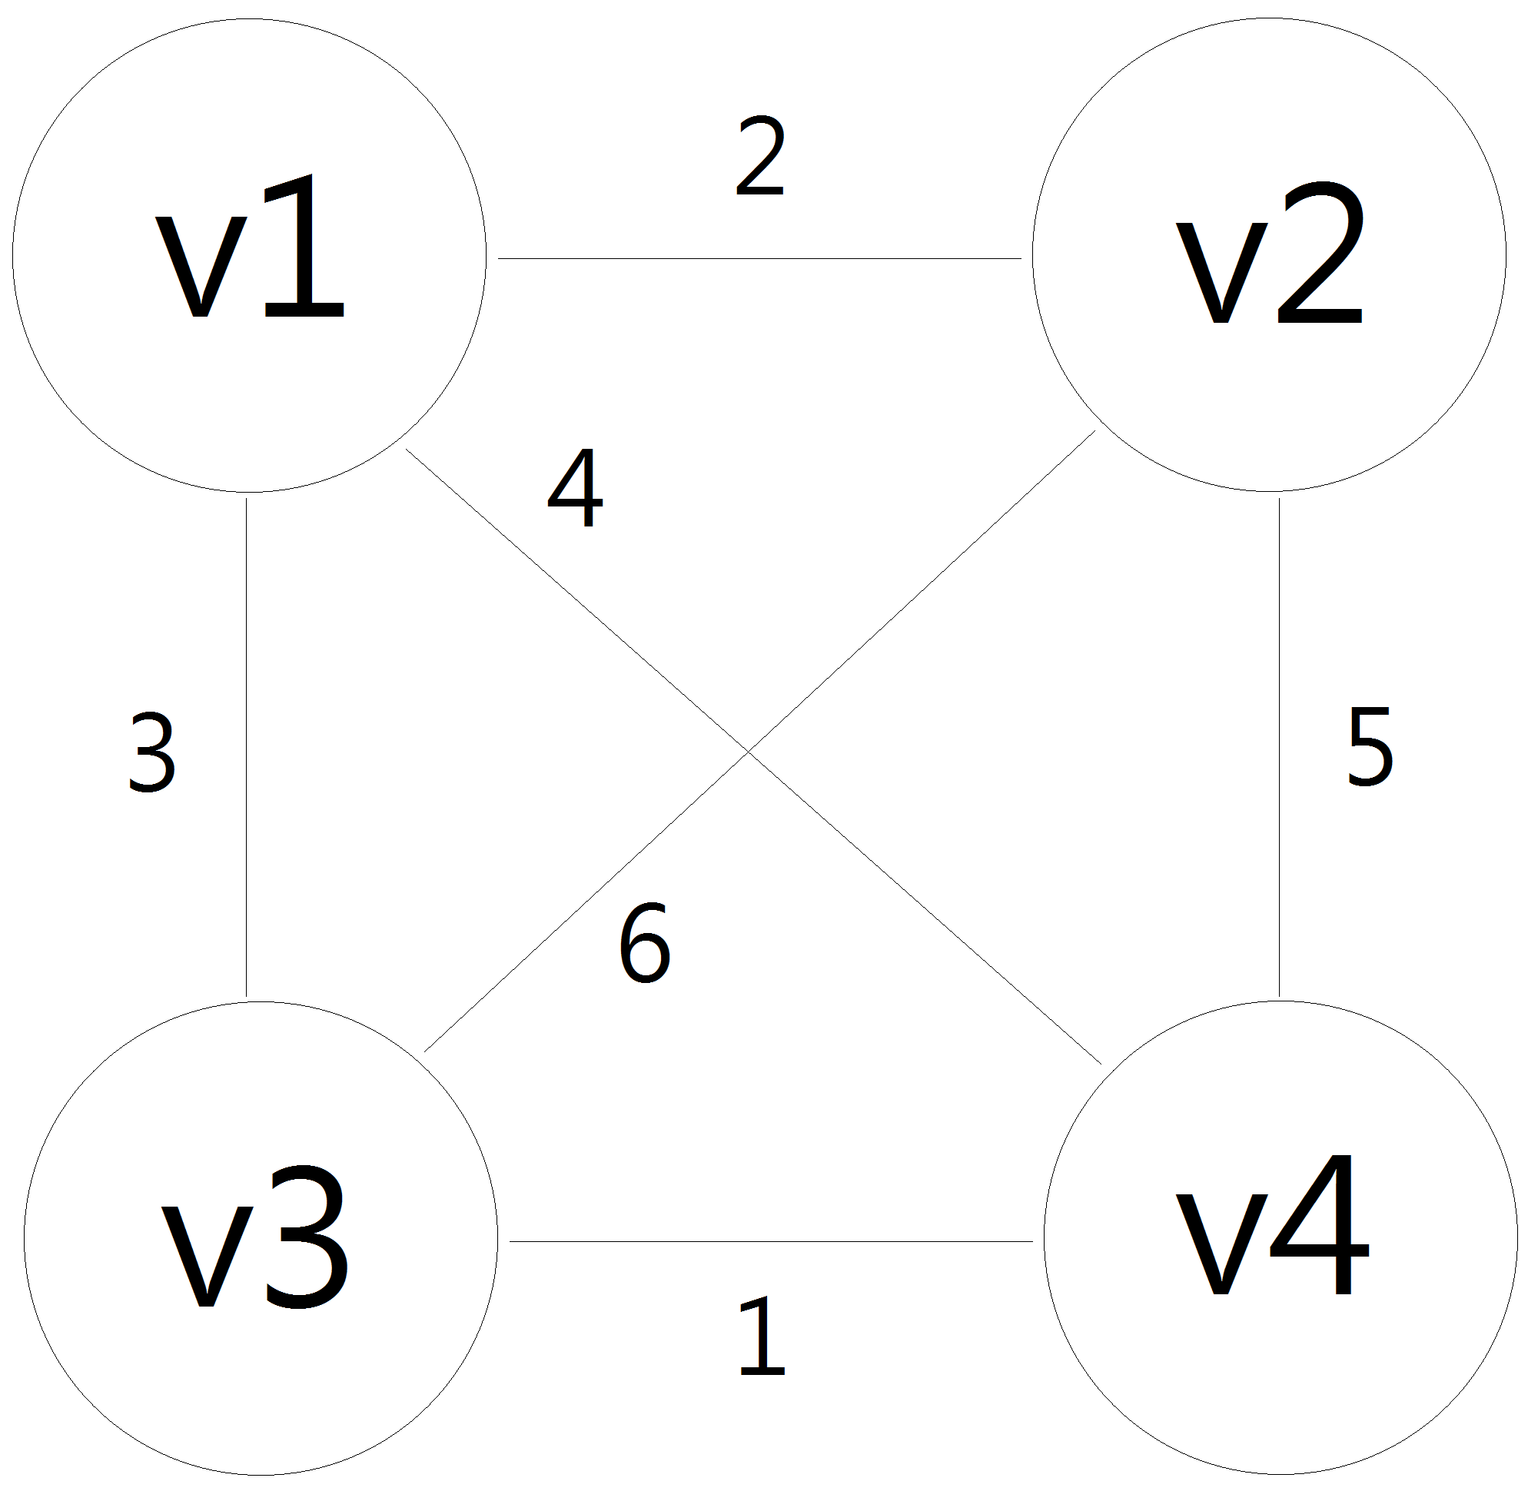
Graph 1

Slide 3
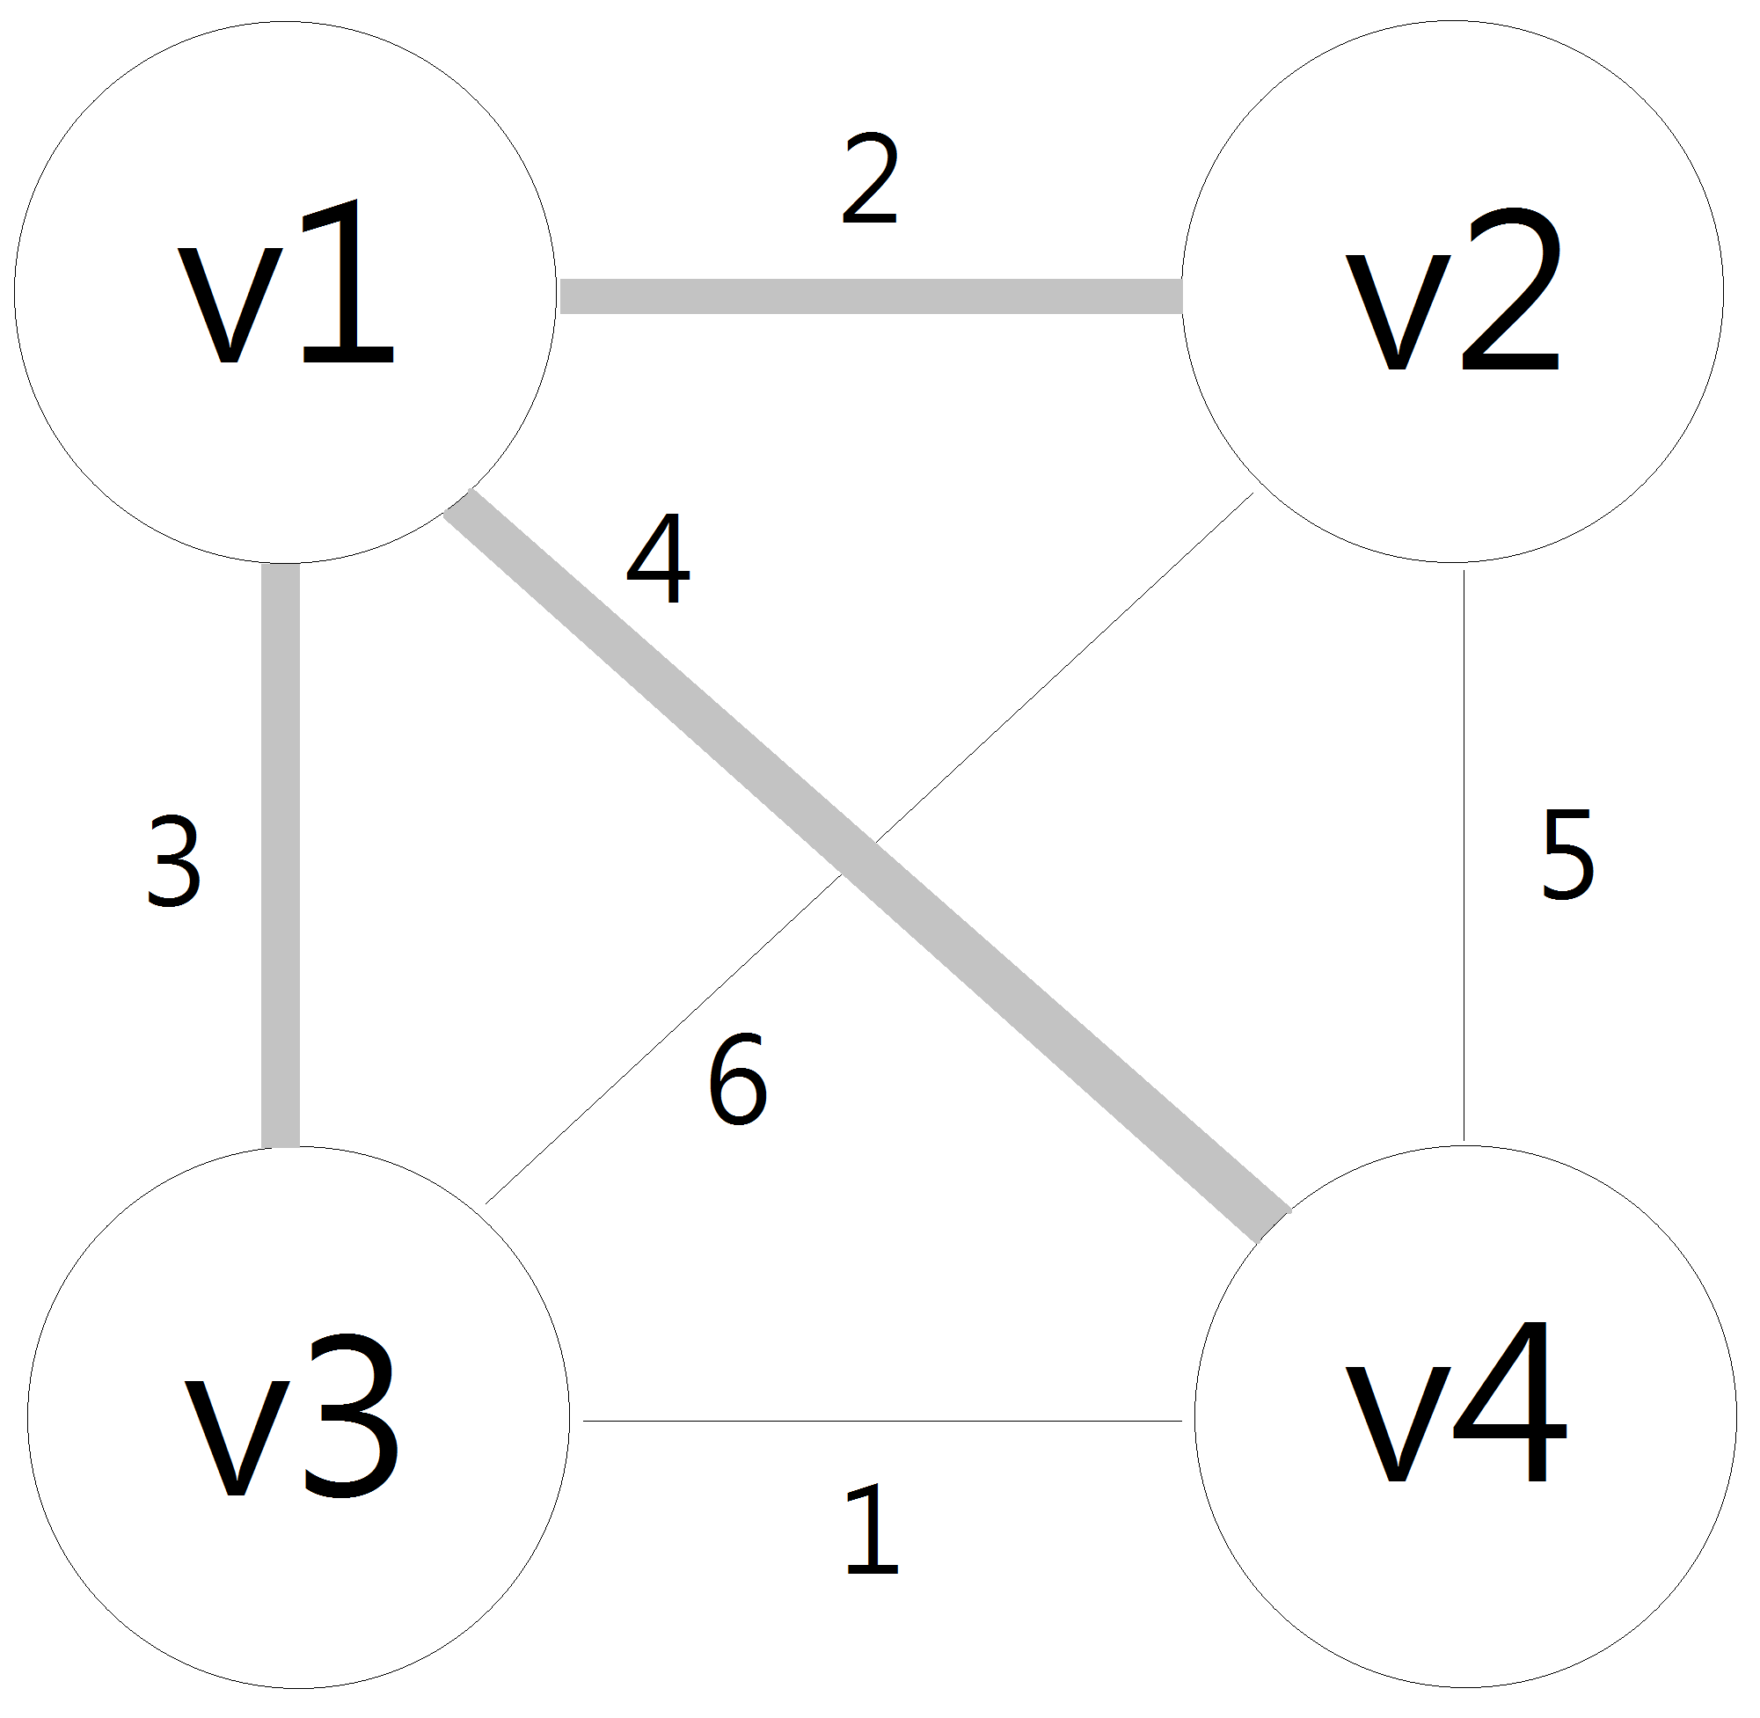
Step 1

Slide 4
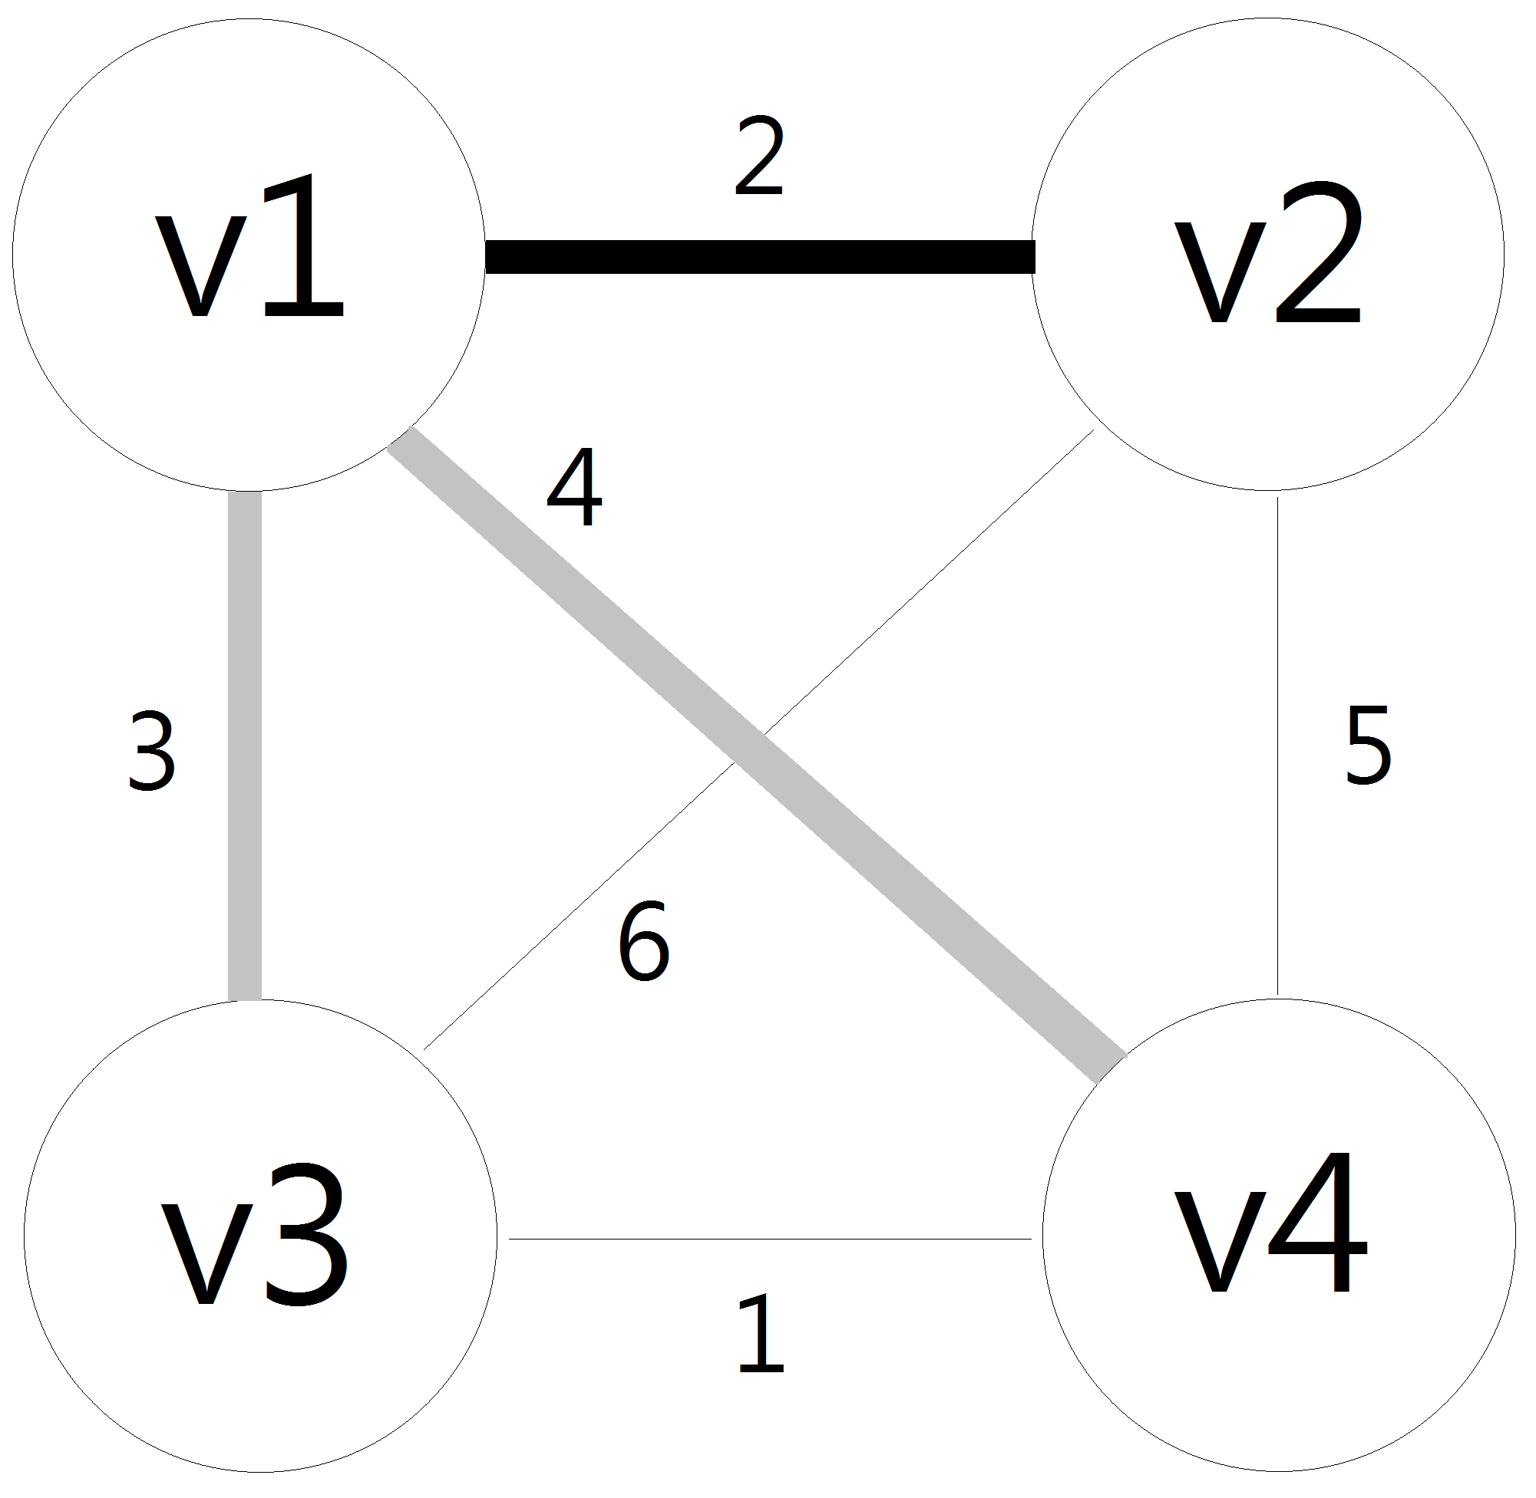
Step 2

Slide 5
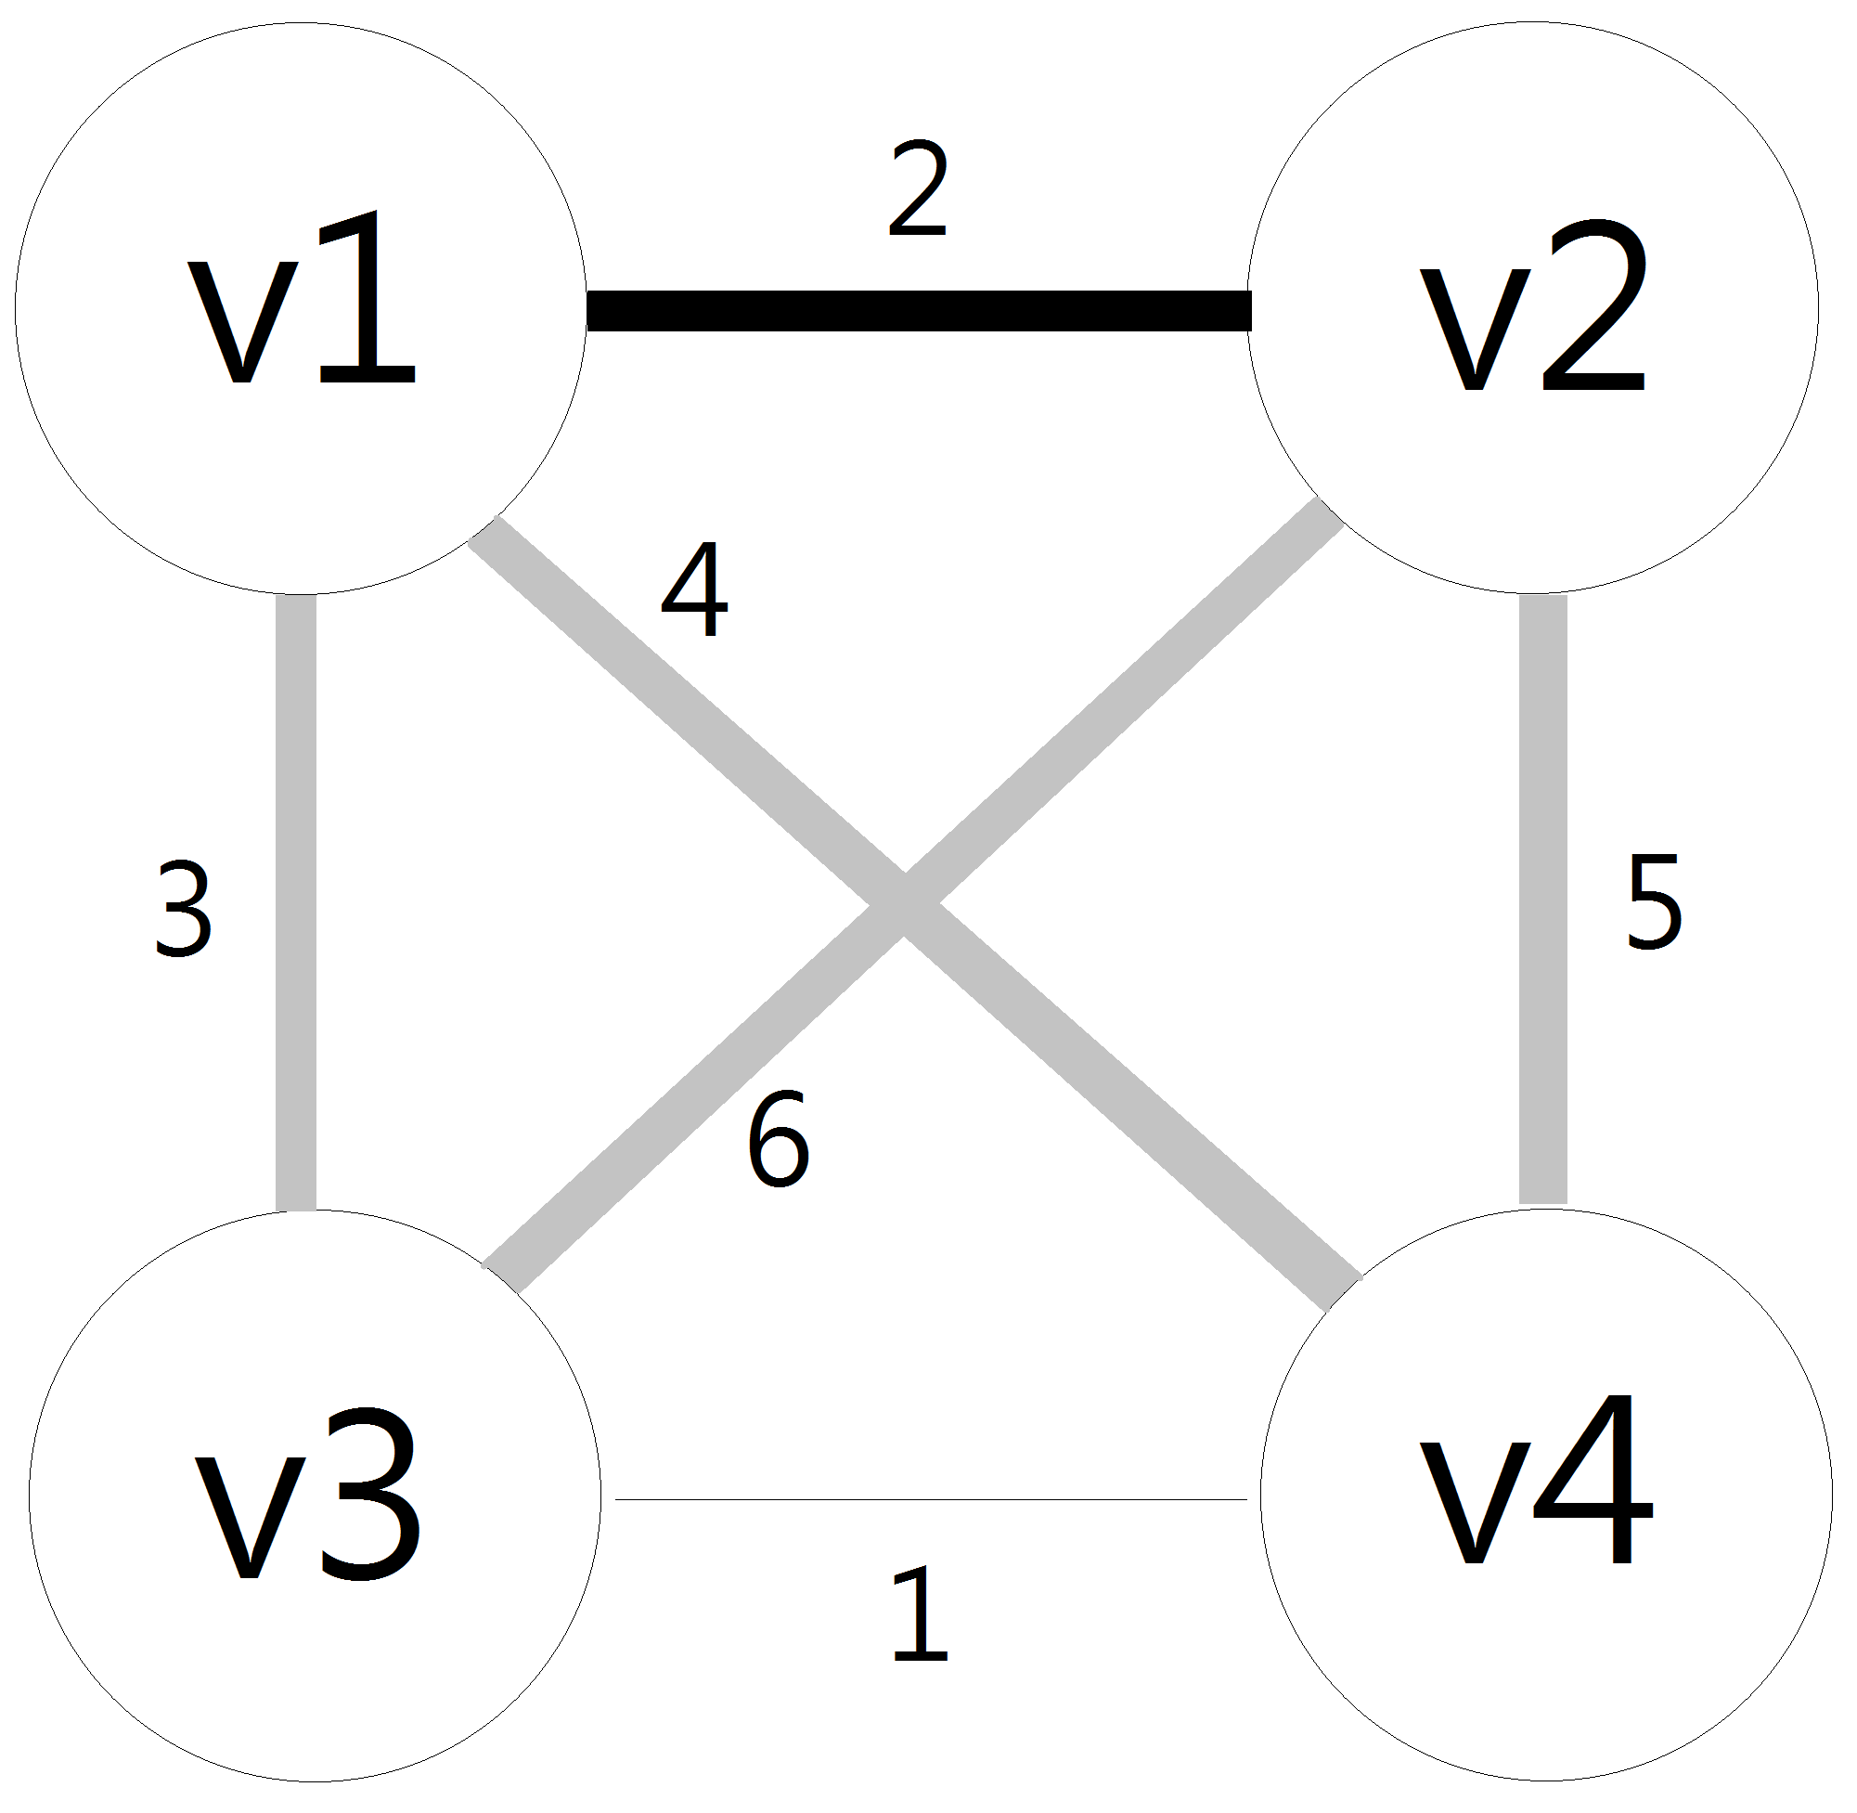
Step 3

Slide 6
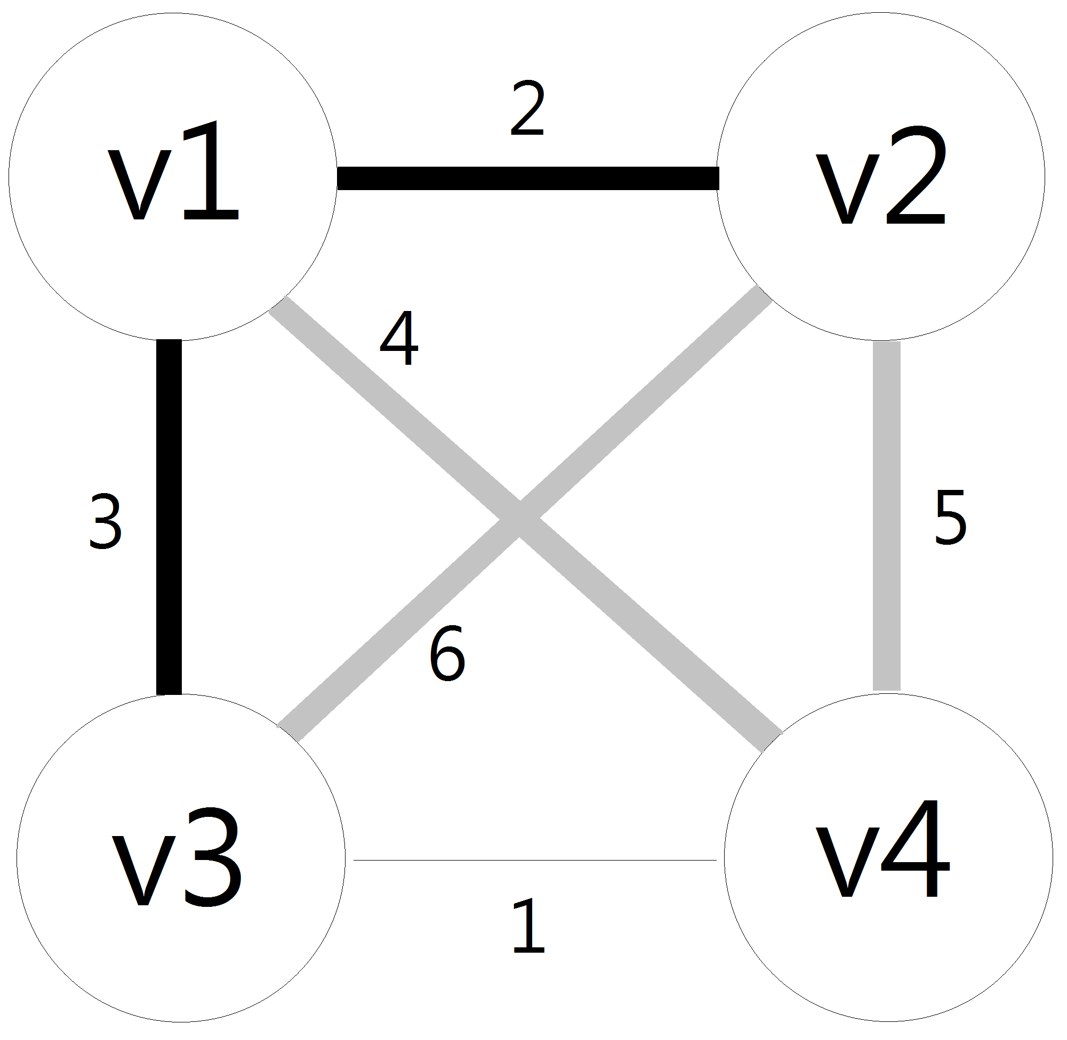
Step 4

Slide 7

Step 5

Slide 8
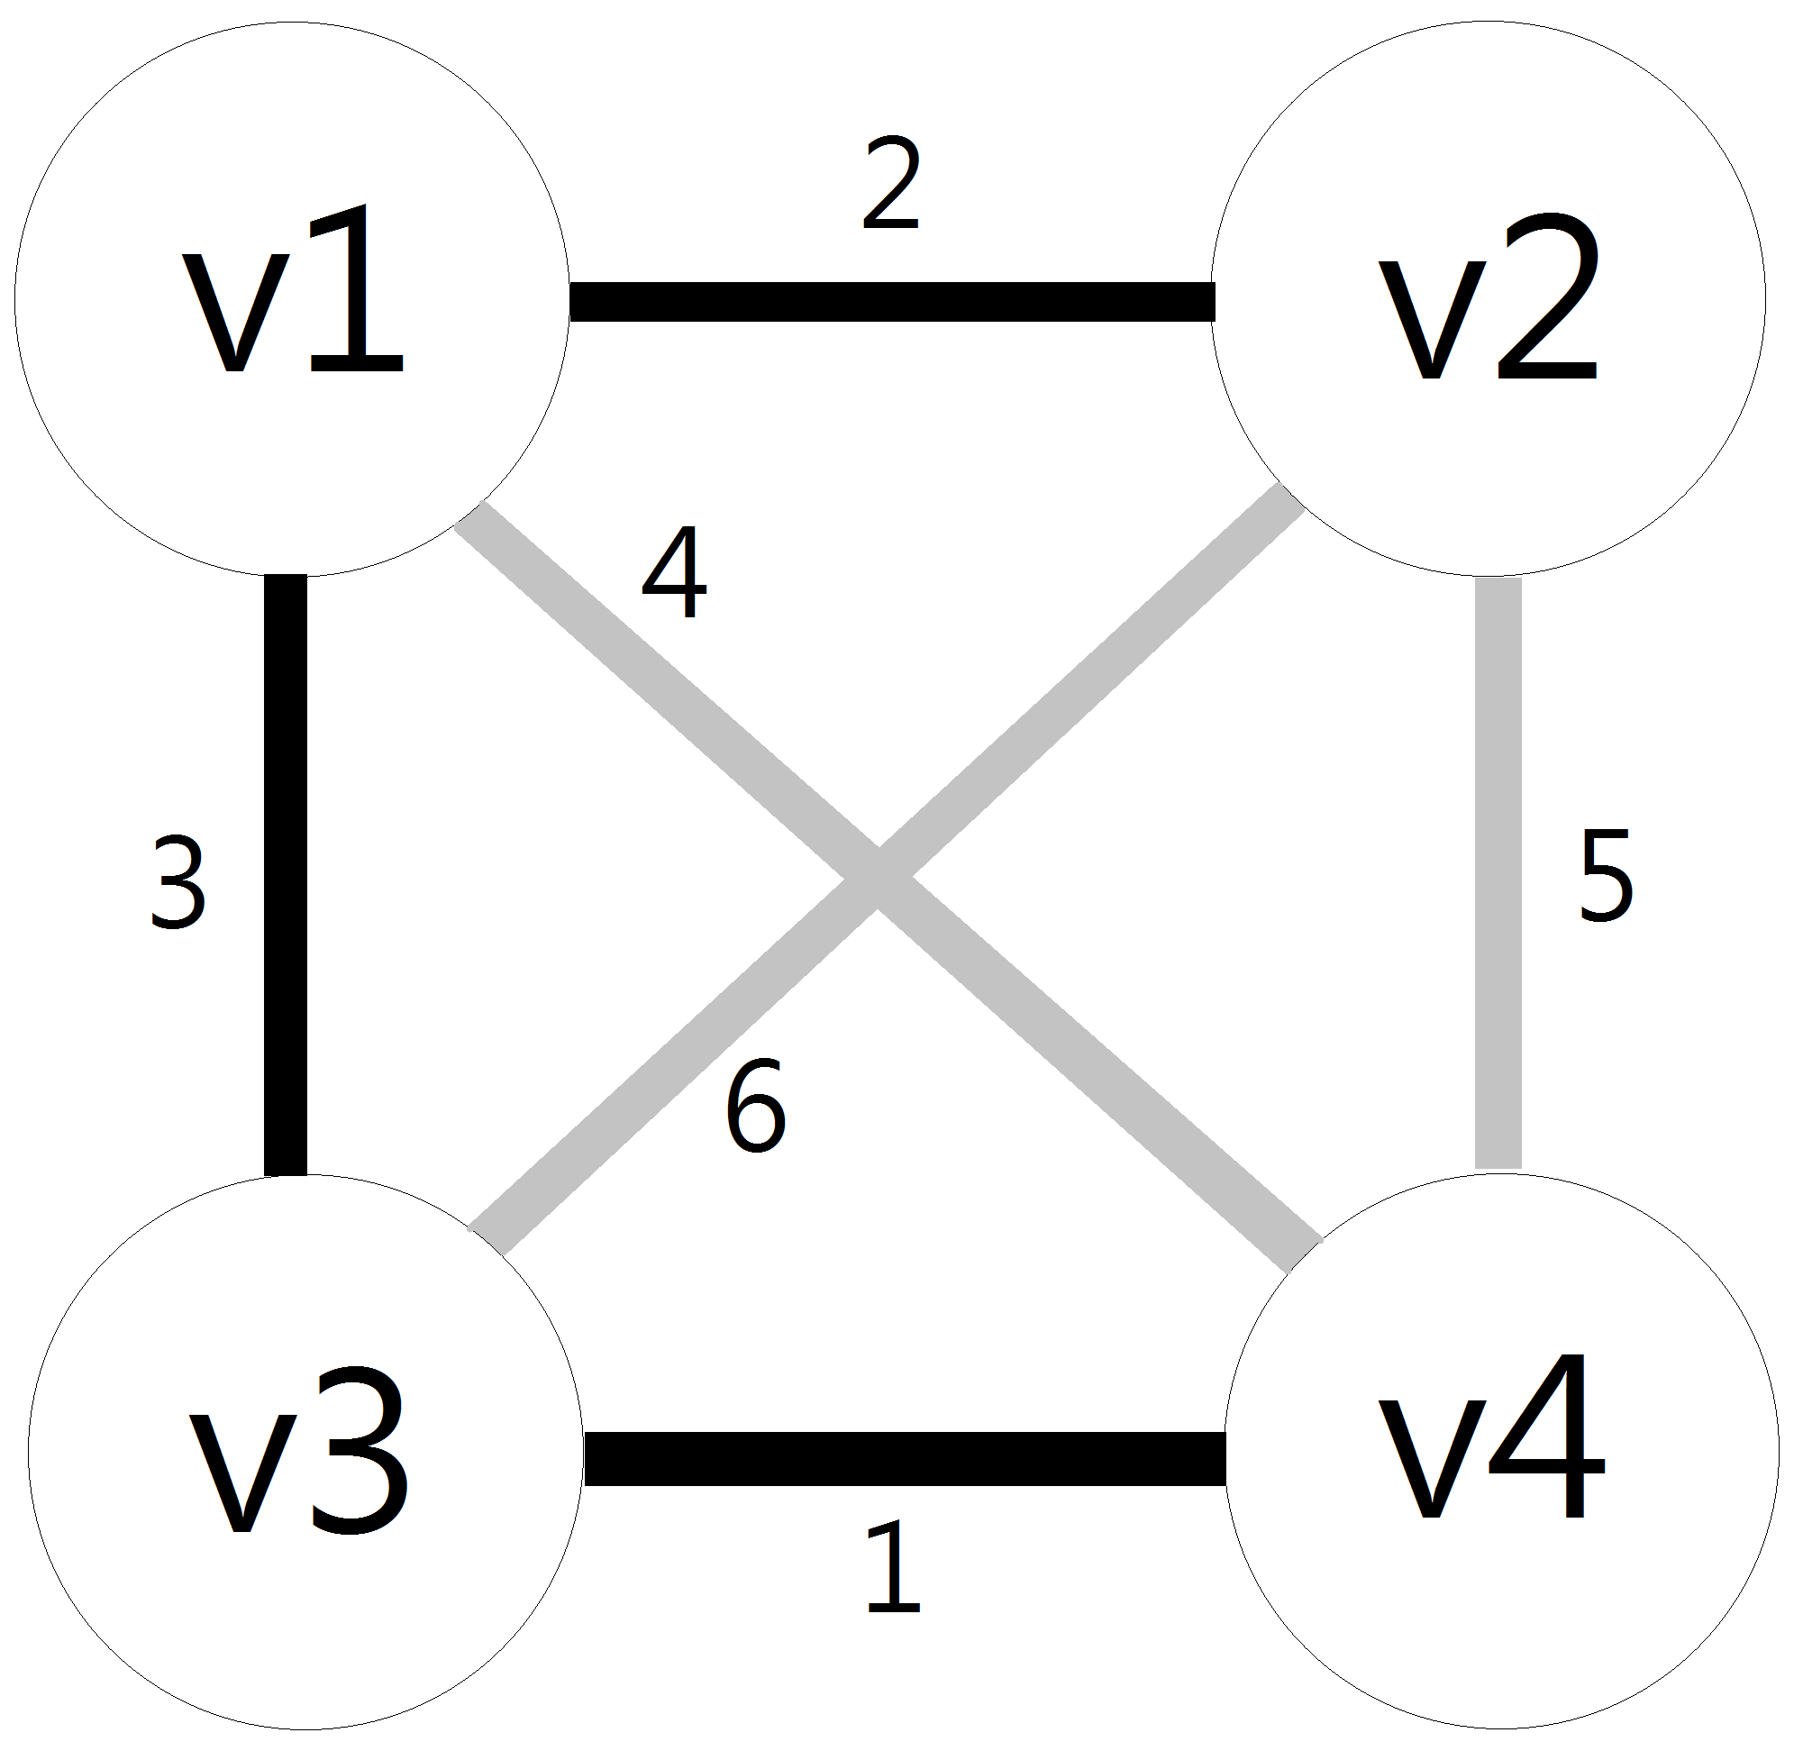
Step 6

Slide 9
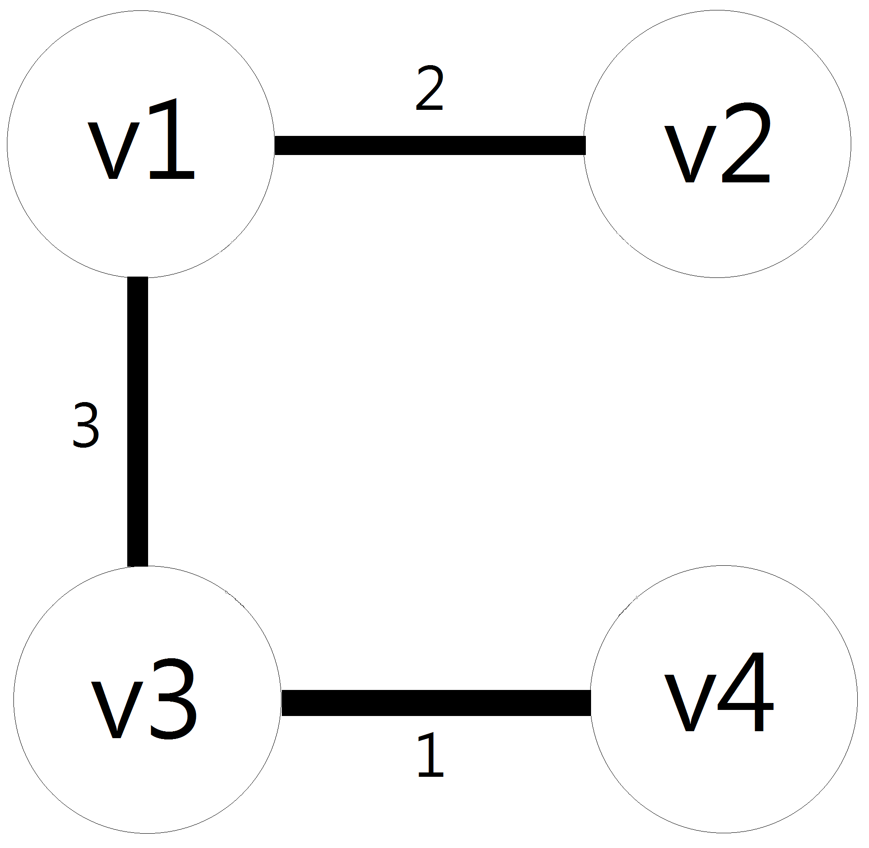
Result
We have gotten enough edges(n-1), so don’t have to search anymore.
The weight of the MST is 6.

Slide 10
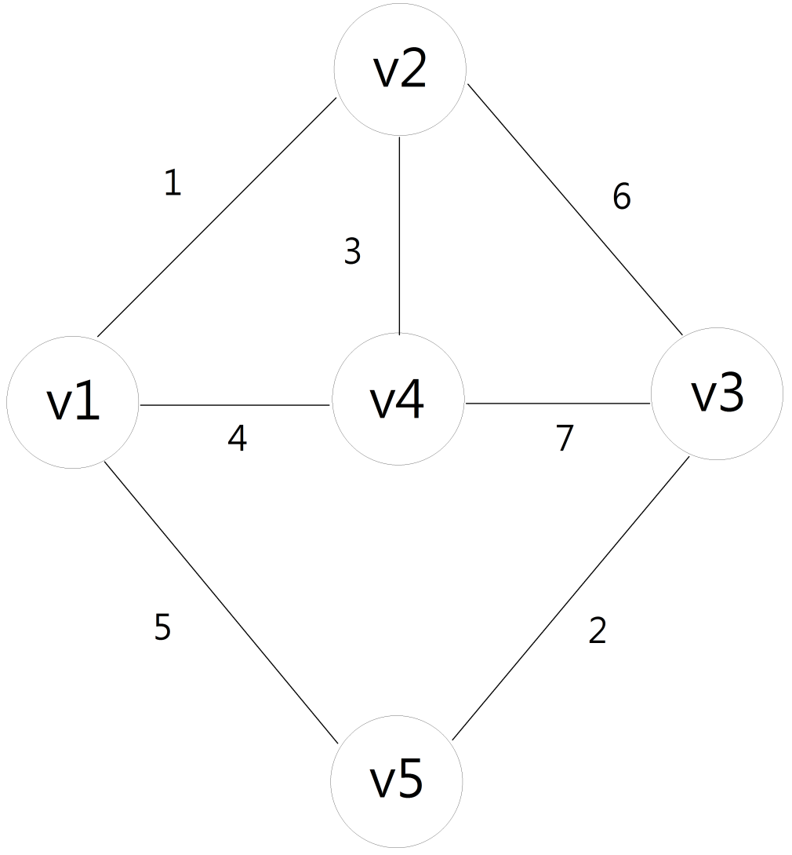
Graph 2

Slide 11
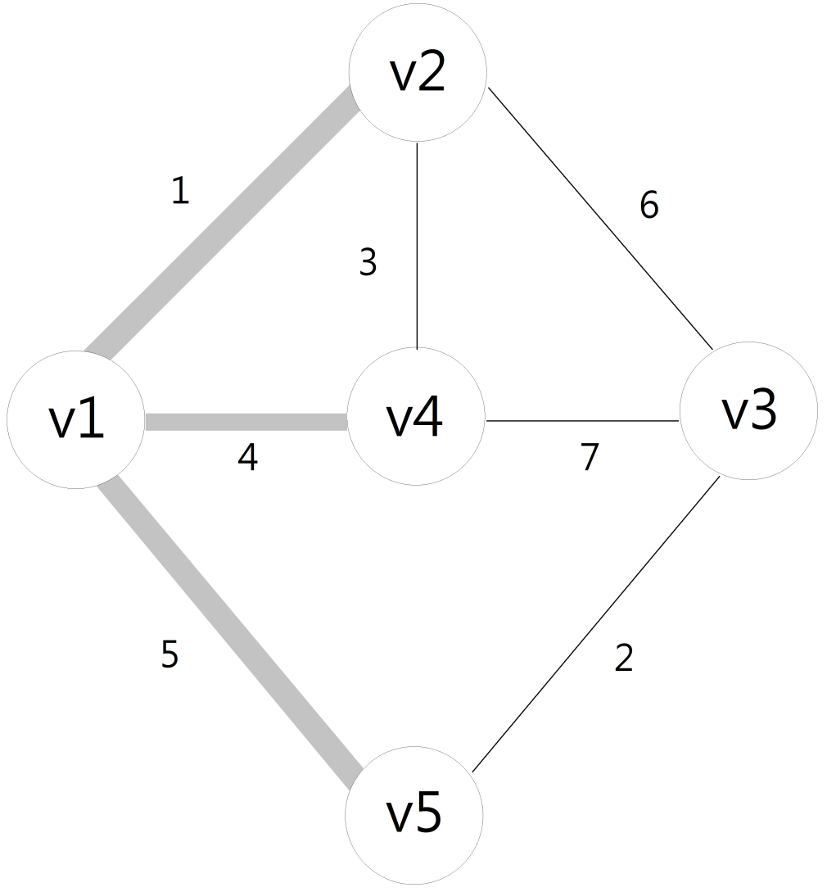
Step 1

Slide 12
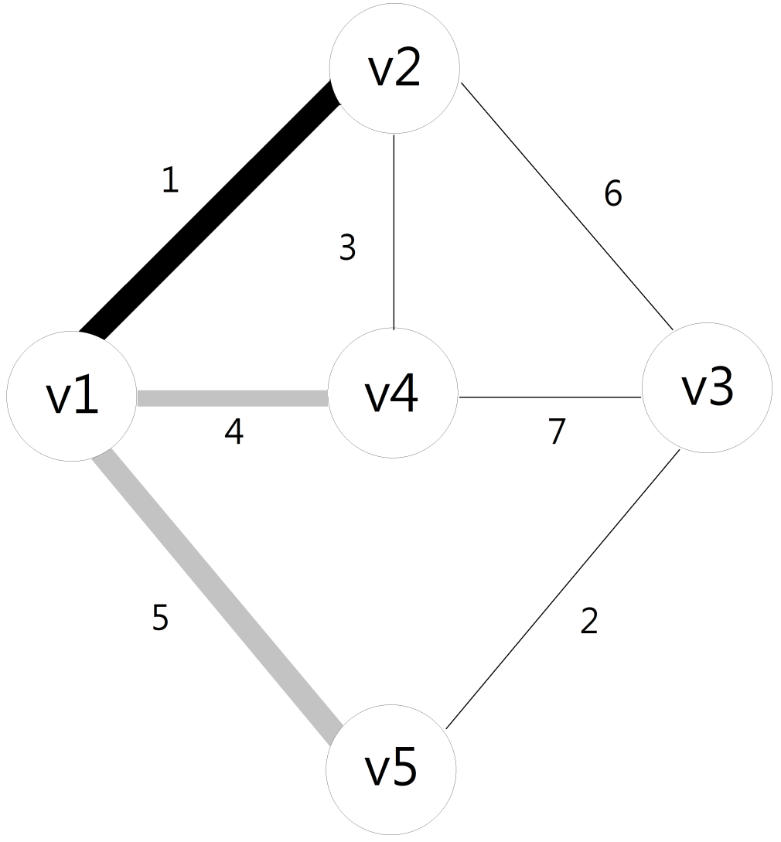
Step 2

Slide 13

Step 3

Slide 14
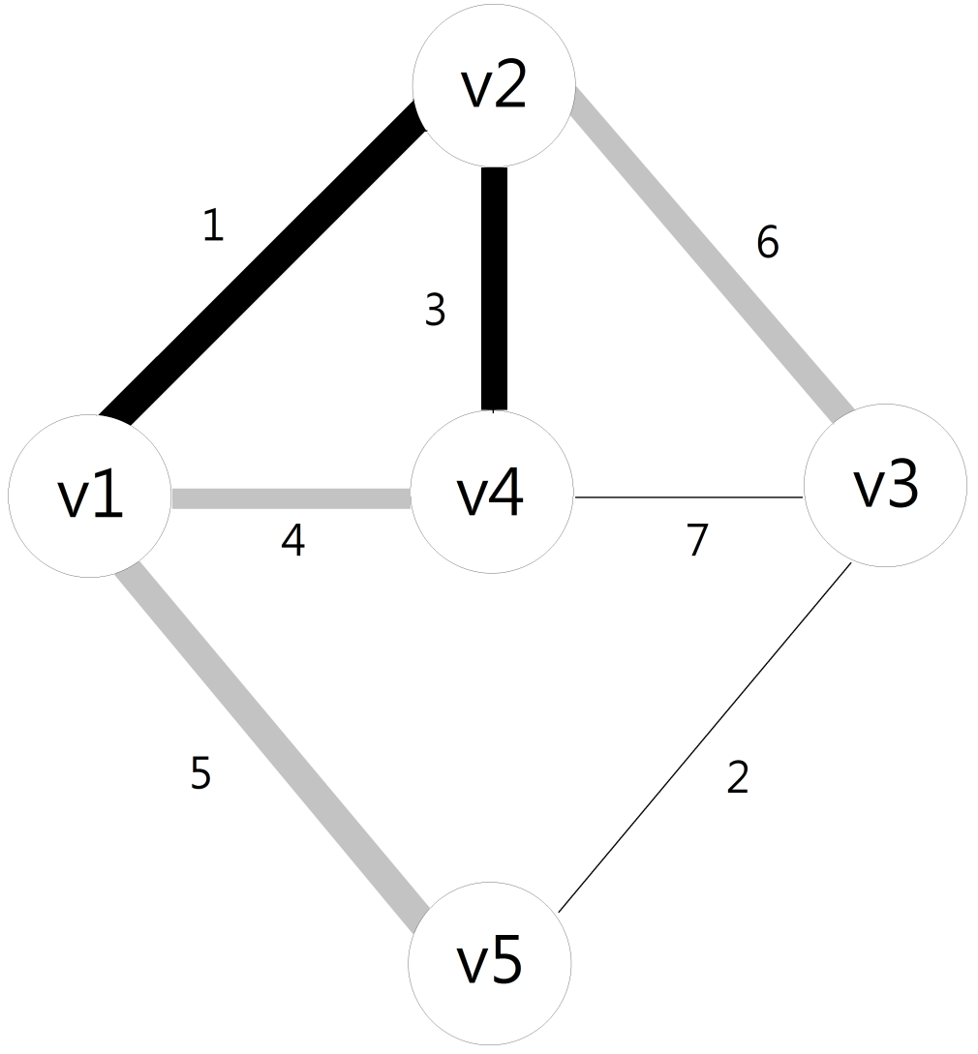
Step 4

Slide 15
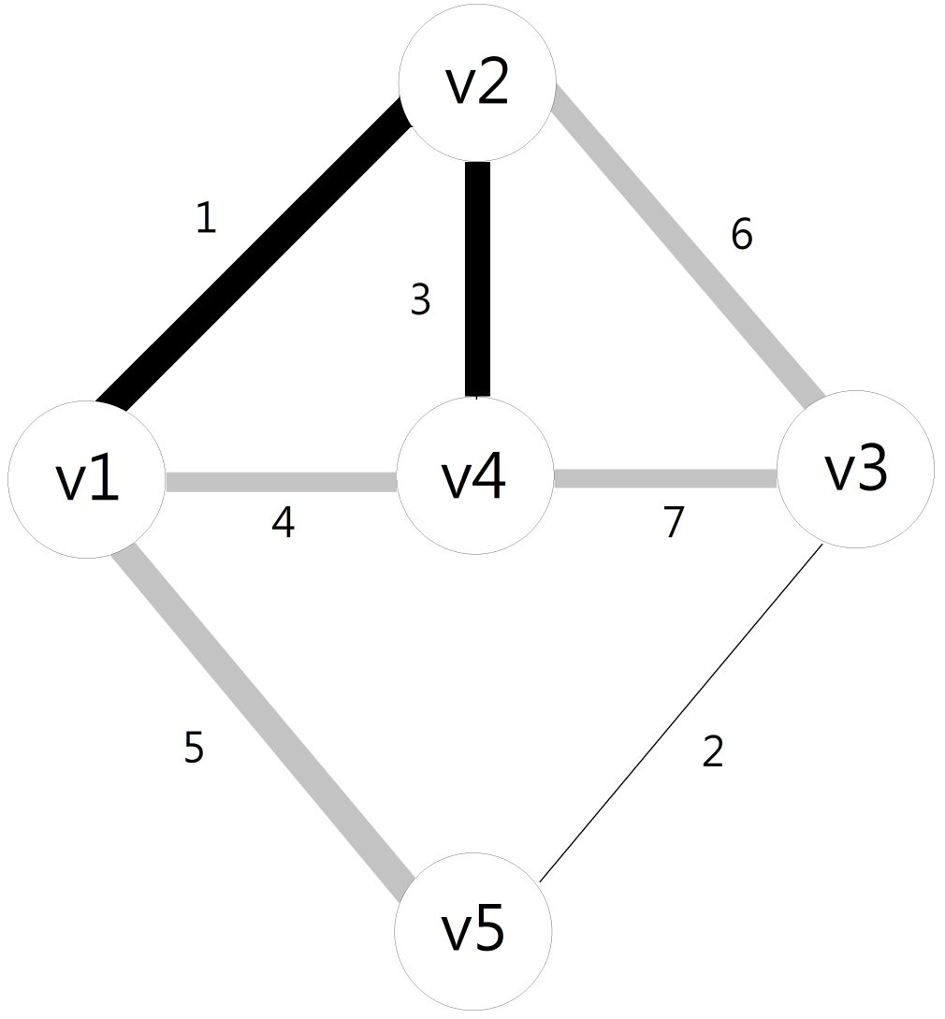
Step 5

Slide 16

Step 6
Edge v1-v4 is the smallest weight we’ve searched.
But it will generate a loop, cannot choose it.

Slide 17
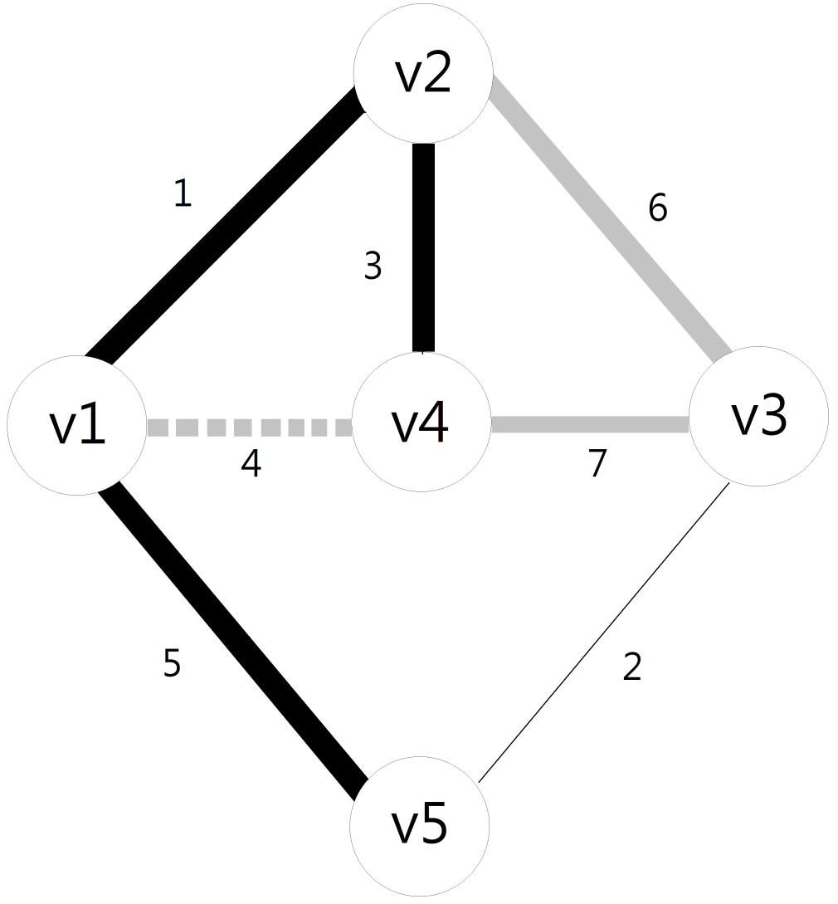
Step 7

Slide 18

Step 8

Slide 19
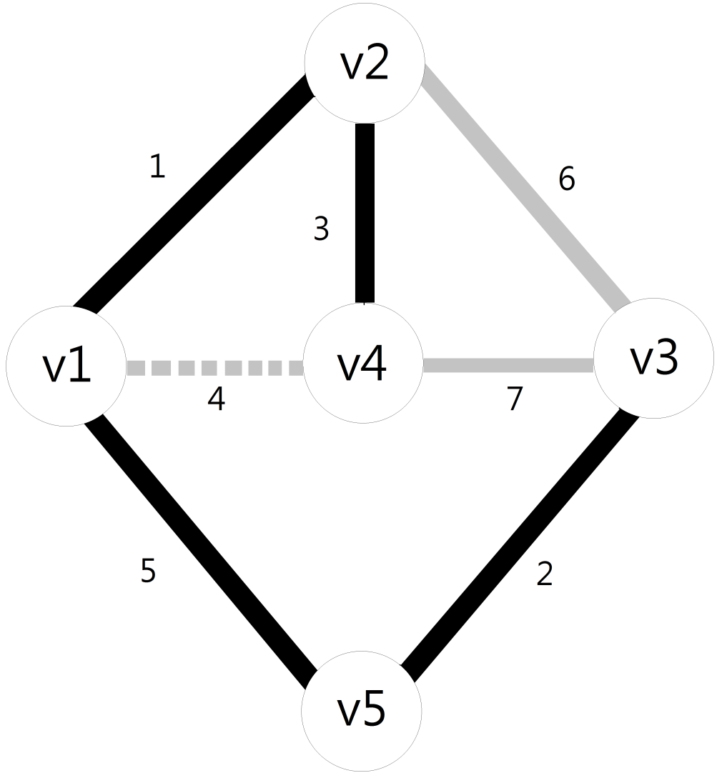
Step 9

Slide 20
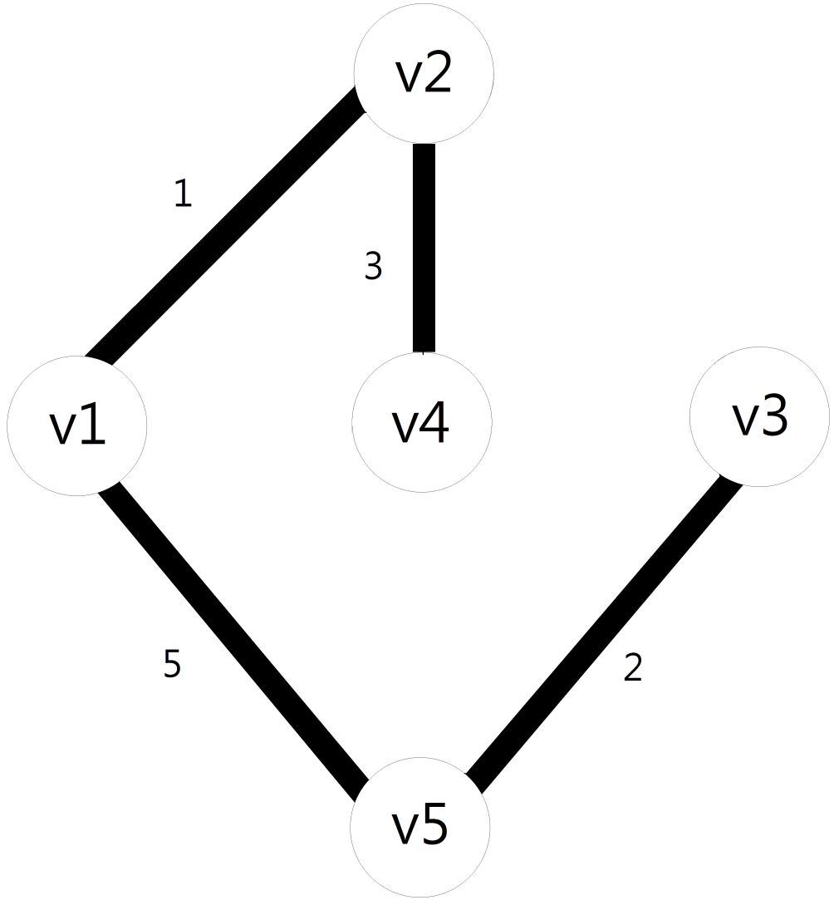
Result
The weight of the MST is 11.

Slide 21
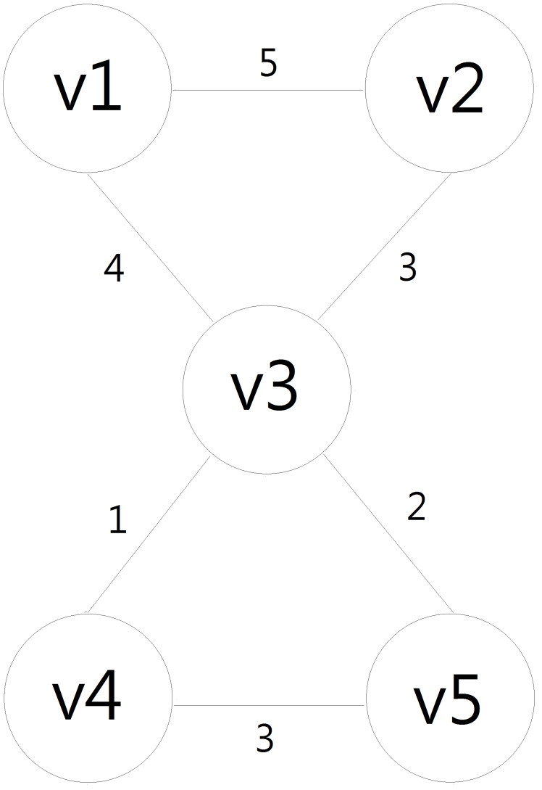
Graph 3

Slide 22
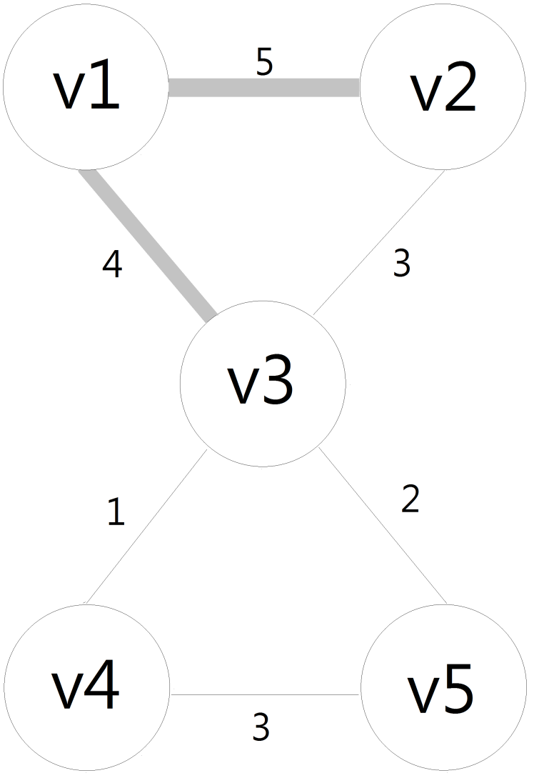
Step 1

Slide 23
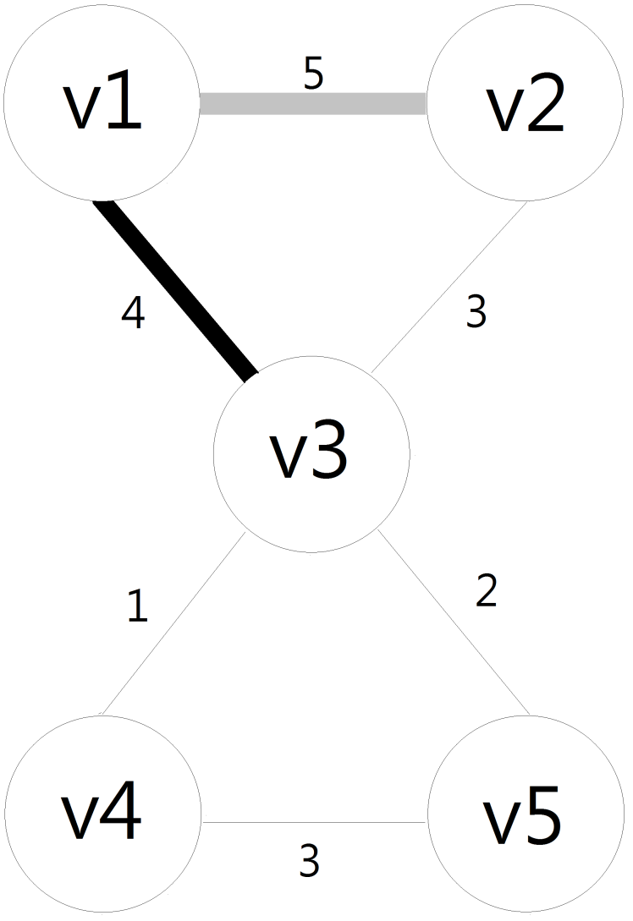
Step 2

Slide 24
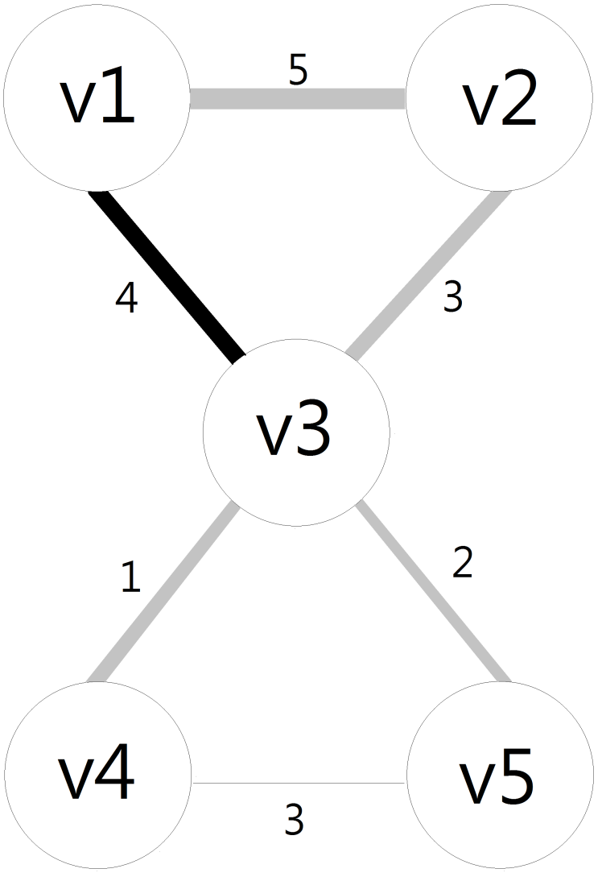
Step 3

Slide 25
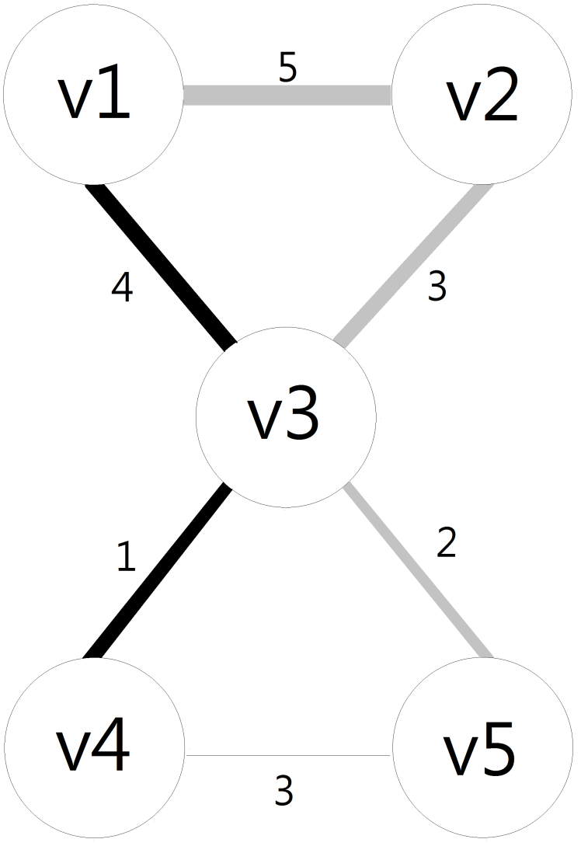
Step 4

Slide 26
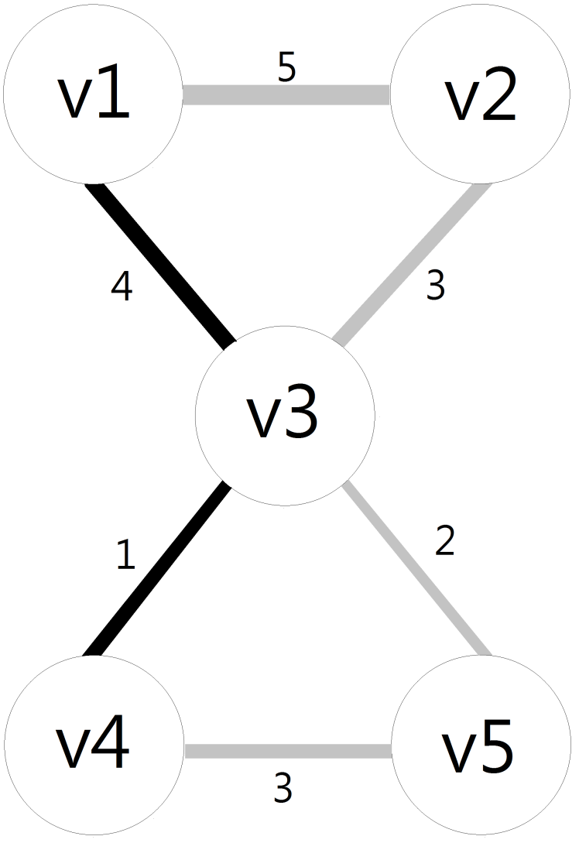
Step 5

Slide 27
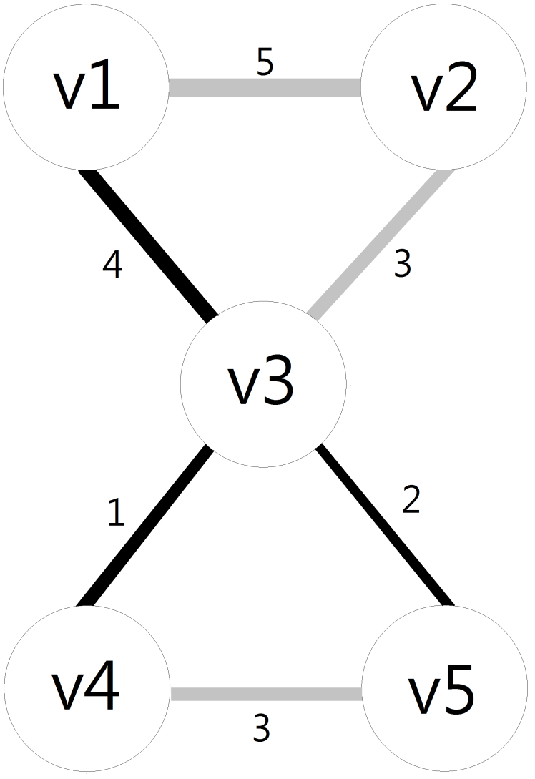
Step 6

Slide 28
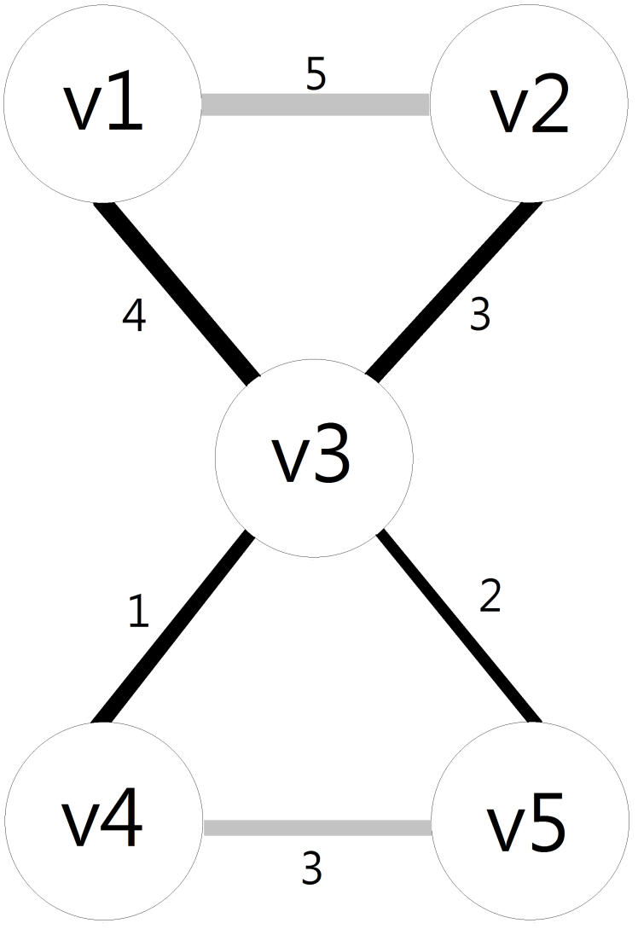
Step 7
Edge v2-v3 and v4-v5 have the same weight. Pick one of them whatever you want.

Slide 29
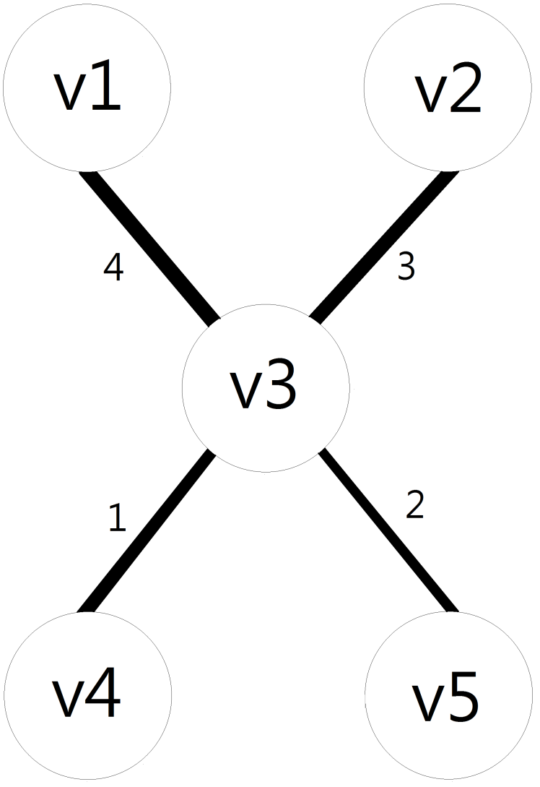
Result
The weight of the MST is 10.

Slide 30
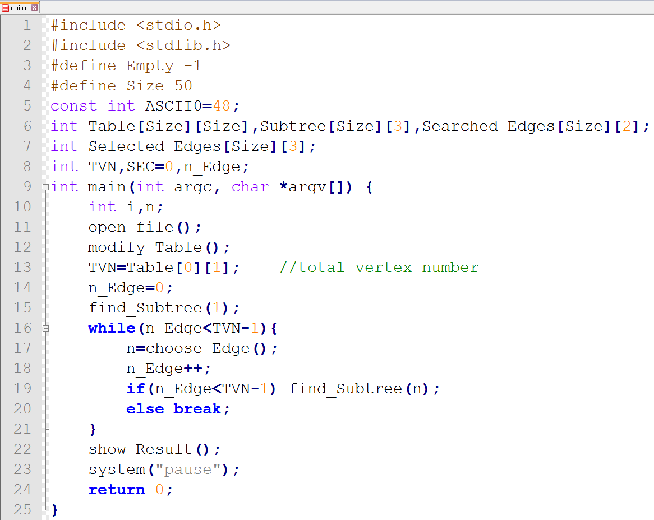
Coding structure

Slide 31
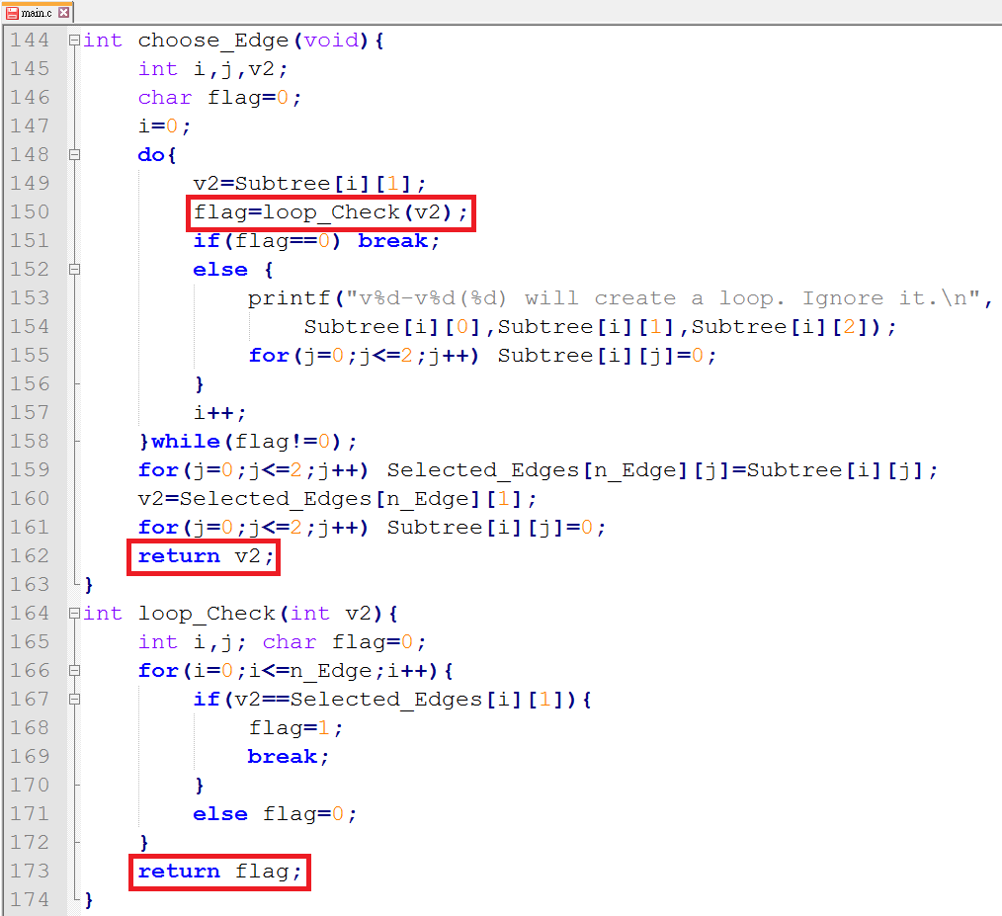
How to choose the edge?

